Slide 1

Note: The data and information in this document is reflective of a hypothetical situation and client. This document is to be used for KPMG Virtual Internship purposes only.
Sprocket Central Pty Ltd
Data analytics approach
[Division Name] - [Engagement Manager], [Senior Consultant], [Junior Consultant]

Slide 2
Note: The data and information in this document is reflective of a hypothetical situation and client. This document is to be used for KPMG Virtual Internship purposes only.
Agenda
Introduction
Data Exploration
Model Development
Interpretation

Slide 3
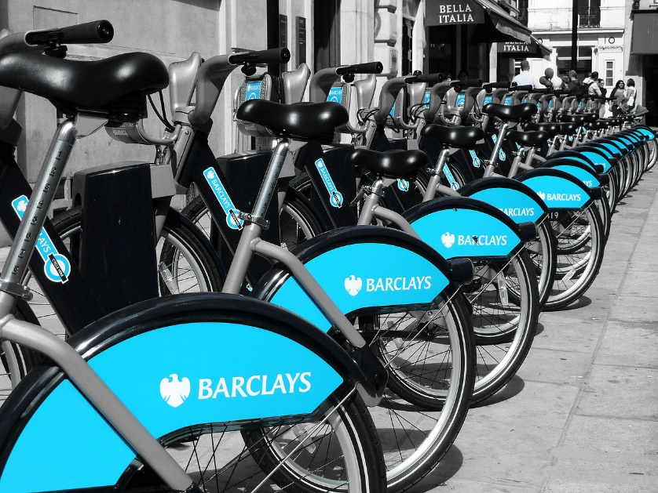
Note: The data and information in this document is reflective of a hypothetical situation and client. This document is to be used for KPMG Virtual Internship purposes only.
Introduction
Sprocket Central Pty Ltd , a medium size bikes & cycling
accessories organization
Sprocket Central Pty Ltd needs help with its customer and transactions data. The organization has a large dataset relating to its customers, but their team is unsure how to effectively analyze it to help optimize its marketing strategy.
The client provided KPMG with 3 datasets:
Customer Demographic
Customer Addresses
Transactions data in the past 3 months

Slide 4
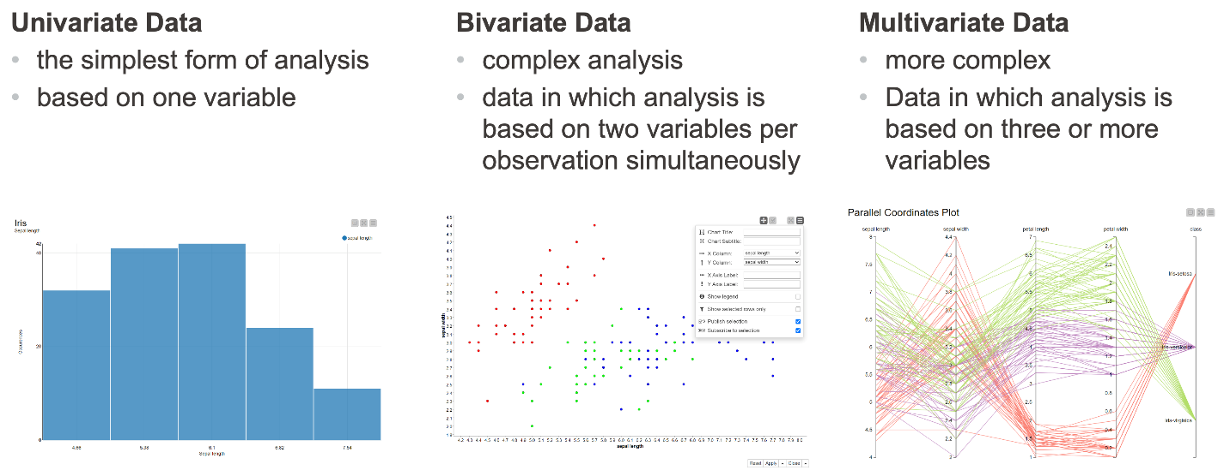
Note: The data and information in this document is reflective of a hypothetical situation and client. This document is to be used for KPMG Virtual Internship purposes only.
Data Exploration
Exploratory Data Analysis is used to answer questions, test business assumptions, generate hypotheses, and is used to prepare the data for modeling.
Variable Identification
Univariate Analysis
Bi-variable Analysis
Treating missing values
Treating outliers

Slide 5
Note: The data and information in this document is reflective of a hypothetical situation and client. This document is to be used for KPMG Virtual Internship purposes only.
Model Development
For our model we are going to make some feature engineering, based on previous data exploratory analysis.
1. Select the most valuable features from the datasets.
2. Append it with additional features from the external resources if necessary.
3. Select a model according to the hypothesis (Linear, SVM, PCA, DT and RF, NN ).
4. Choose loss function for training

Slide 6
Note: The data and information in this document is reflective of a hypothetical situation and client. This document is to be used for KPMG Virtual Internship purposes only.
Interpretation
There are a wide variety of new model interpretation techniques.
Linear Models: for predictive analysis of the revenue from the customer
Classification: developing new classes for the customers to clearly identify their potential for us and our resources spending on them
Place any supporting images, graphs, data or extra text here.

Slide 7
Note: The data and information in this document is reflective of a hypothetical situation and client. This document is to be used for KPMG Virtual Internship purposes only.
Appendix

Slide 8
Note: The data and information in this document is reflective of a hypothetical situation and client. This document is to be used for KPMG Virtual Internship purposes only.
Appendix
This is an optional slide where you may place any supporting items.

